Slide 1
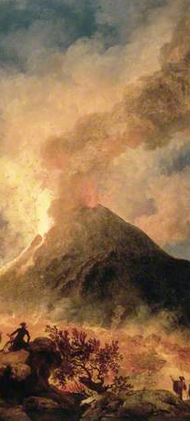
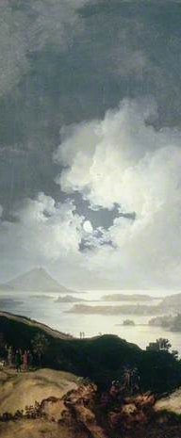
Join the Neapolitan Network:
http://www.york.ac.uk/history-of-art/research/neapolitan
for all research on Naples
Naples at
Compton Verney
Naples at Compton Verney
Naples at Compton Verney
Organized by
Helen Hills (helen.hills@york.ac.uk)
Department of History of Art
University of York
In collaboration with
Compton Verney
Sponsored by
Research School for Architectural History & Theory & Department of History of Art University of York
International Symposium
17 June 2015
Programme
International Symposium
17 June 2015
Programme

Slide 2
11.00: Compton Verney opens to the public 11.15: Helen Hills (University of York): Introduction & Welcome 11.25: Joris van Gastel (University of Hamburg): 'Figs and Guinea Pigs: Colonial Traces in the Neapolitan Still Life ' 11.50: Letizia Treves (Curator of Italian and Spanish Paintings 1600-1800, The National Gallery, London), ‘The formation of the Neapolitan baroque paintings collection at the National Gallery in London’ 12.15: Discussion 12.30: Lunch for speakers | Chair: Joris van Gastel (University of Hamburg) 1.30: Helen Hills (University of York) 'Breathing Fire: Vesuvius, Miraculous Blood and Neapolitan Baroque Architecture' 1.50: Helena Hammond (Roehampton University) ‘Coffee and conciliation: Giovanni Paolo Panini’s Meeting of Carlo di Borbone and Pope Benedict XIV at the Quirinal Coffee House in 1744 and the new cultural politics of Bourbon sovereignty in eighteenth-century Naples’ 2.10: Discussion 2:25 Tea &Coffee break | 2.55 Bogdan Cornea (PhD student, University of York): ‘Surfaces of Violence in Jusepe de Ribera's Martyrdom s of Saint Bartholomew’ 3.25: Josephine Neil (PhD student, King’s College London) ‘Darkness in Giambattista Caracciolo's Baptism of Christ: knowing and unknowing the divine’ 3.45-3.50: Paola Viola (University of Catania): ‘The Kingdom of Sicily database project.’ 4.10: Informal Discussion / Highlights of the Neapolitan Collection Tour (suitable for general public)

